Slide 1
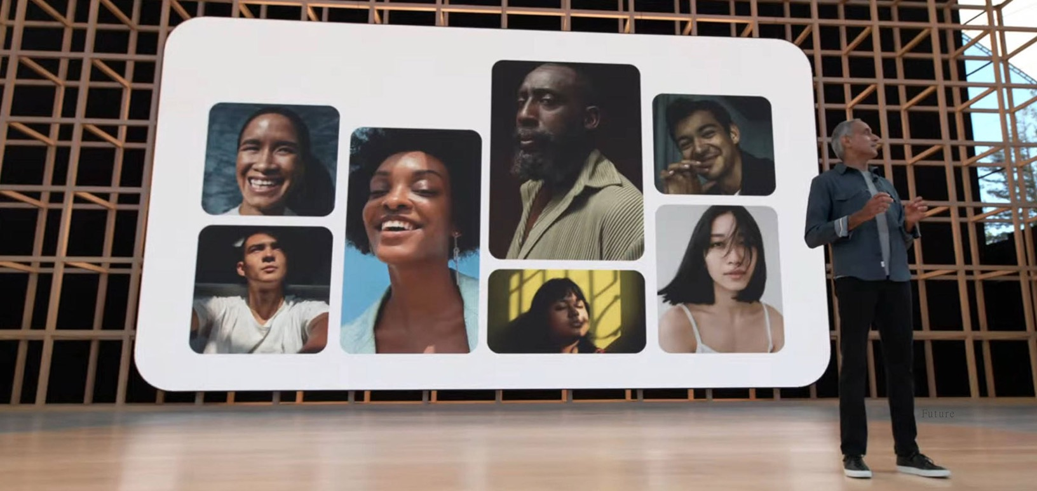
What’s happening in the news this week?
Let’s have a look at this week’s poster!
20th – 26th June 2022

Slide 2
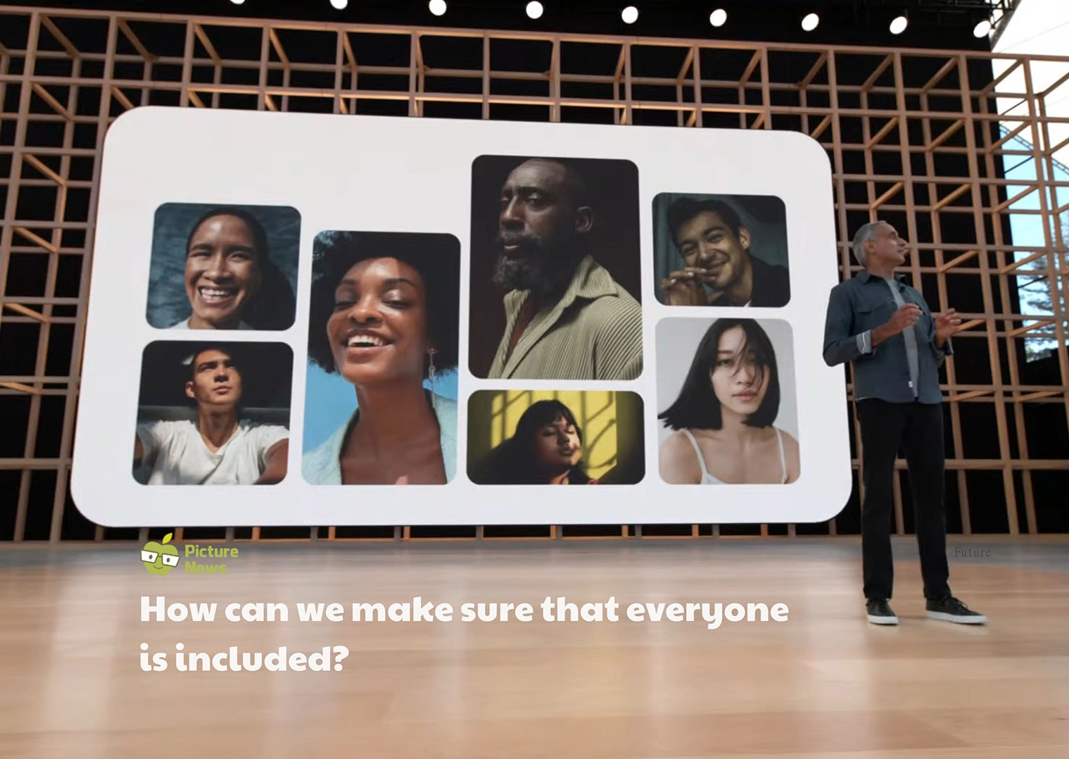

Slide 3
Let’s look at this week’s story
The technology company, Google, has recently announced changes to its search engine, including the introduction of the ‘Monk Skin Tone Scale’ to help make search results
more inclusive by showing a wider range of skin tones. Professor Dr Ellis Monk (creator of the Monk Skin Tone Scale) and Google aim to tackle the unfair balance of skin tones we see when searching online. The Monk Skin Tone Scale has 10 skin tones.
Learn more about this week’s story here.
Watch this week’s useful video here.
This week’s Virtual Assembly here.
© Picture News 2022

Slide 4
This week’s story looks at events related to …
North America
Europe
Asia
Africa
Google Headquarters
Mountain View, California
South America
Australia
Antarctica
© Picture News 2022

Slide 5
How does it make me feel?
sad
angry
happy
confused
excited
worried
shocked
afraid
despondent
disconsolate
dismal doleful downhearted forlorn gloomy melancholic miserable woeful wretched
aggrieved annoyed discontented disgruntled distressed exasperated frustrated indignant offended outraged resentful vexed
beaming buoyant cheery contented delighted enraptured gleeful glowing joyful
addled baffled bemused bewildered disorientated indistinct muddled mystified perplexed puzzled
animated elevated enlivened enthusiastic exhilarated exuberant thrilled
agitated anxious apprehensive concerned disquieted distraught distressed disturbed fretful perturbed troubled uneasy
astonished astounded disconcerted distressed dumbfounded horrified staggered startled stunned surprised
alarmed apprehensive daunted fearful frantic horrified petrified terrified
© Picture News 2022

Slide 6
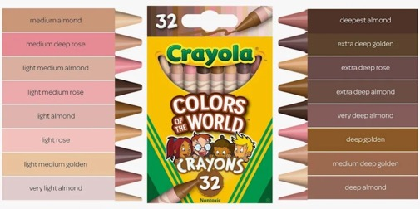
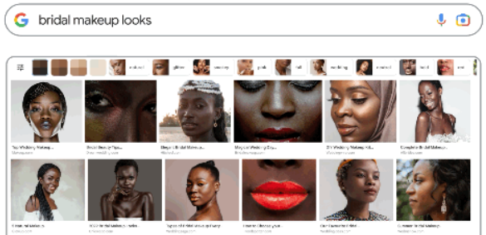
ASSEMBLY RESOURCE
Read through the information below about the Monk Skin Tone Scale and Crayola’s crayons.
What is the Monk Skin Tone Scale?
Crayola Colours of the World
The Monk Skin Tone Scale, named after professor Dr Ellis Monk, has 10 different skin tones. Google has said it is using the scale to improve things like search options and image results. This technology aims to make everyone feel more included when using and searching the internet.
Last year, Crayola revealed its Colours of the World crayons. The 24 shades are said to represent around 40 different skin tones. Rich Wuerthele, the boss at Crayola says, “With the world growing more diverse than ever before, Crayola hopes our new Colours of the World crayons will increase representation and foster a greater sense of belonging and acceptance”.
Source: Google
How will it work?
When searching for people-related images on Google Images, users will see an option to filter results by skin tone. For example, someone planning a wedding and searching for 'bridal makeup looks' can then choose their skin tone and be shown results unique to them.
Source: Crayola
Can you think of times when you have felt included?
Source: Google
© Picture News 2022

Slide 7
Resource
one
Look at the resource below, which shares some examples of people feeling left out.
Josh had forgotten it was non-uniform day at school. When he arrived and realised everyone was wearing clothes from home and he was in school uniform, he felt very left out.
Omesh wasn’t invited to his friend’s birthday party. His friend was only allowed to invite two guests and Omesh wasn’t chosen. He was very upset and disappointed.
Razna moved house and started her first day at a new school. She felt very shy, nervous and lonely as she didn’t know anybody.
Chloe asked if she could join in with the game of football at playtime. She was told to go away as she wasn’t allowed to play.
Elliott wanted to join in with the game his friends were playing at the park. He was told he couldn’t as anyone playing had to have a Poppit and he didn’t have one.
For each, decide if it is intentional or unintentional. What could you do to help each of the people feeling left out?
© Picture News 2022

Slide 8
Resource
two
Look at the resource below, which shares some more information about skin-coloured products.
Make-up There are many different make-up companies that provide different shades to match people’s skin tones. In 2017, Rhianna introduced her own range of make-up as she was frustrated by options for Black and Asian people.
Sun cream Sun cream can leave white marks on skin, which can be more noticeable on darker skin tones. Venus Williams has teamed up with The Sunscreen Company and Credo Beauty to create a more inclusive sun cream for all skin shades and types.
Plasters Many people like to wear skin-coloured plasters so they blend in and are not noticed by others. In 2020, Tesco announced they were making plasters in a variety of skin tones to match people’s skin colour better.
Ballet shoes In the UK, there were no companies making ballet shoes for darker skin tones until 2018.
Dolls and toys Many companies making dolls and toys have tried to become more inclusive by reflecting society.
How do you think it might feel buying a skin-coloured product that does not represent your skin colour?
© Picture News 2022

Slide 9
Reflection
It’s important that we are mindful in all situations of making others feel included, sometimes a small action or change to make others feel welcome can go a long way.
© Picture News 2022

Slide 10
British
Values
Mutual Respect
Not everyone is the same as me and their lives can be very different from mine. If we all try to understand one another, we can help to make sure we all feel included.
© Picture News 2022

Slide 11
UN Rights
of a Child
We all have the right to our own identity, which is an official record of who we are. Our name, nationality, beliefs and ethnicity all form part of our identity.
© Picture News 2022

Slide 12
Useful vocabulary
Acceptance
Included in the group.
As the CEO of Crayola described, do you think it helps everyone feel ‘acceptance’ and ‘belonging’?
Inclusive
Includes and treats everyone fairly.
…to help make search results more inclusive by showing a wider range of skin tones.
Mindful
Conscious or aware of something.
It’s important that we are mindful in all situations of making others feel included.
Online
Bought or used on the internet.
Professor Dr Ellis Monk (creator of the Monk Skin Tone Scale) and Google aim to tackle the unfair balance of skin tones we see when searching online.
Tackle
To try and deal with someone or something.
Professor Dr Ellis Monk (creator of the Monk Skin Tone Scale) and Google aim to tackle the unfair balance of skin tones we see when searching online.
Tone
A form or degree of colour.
Google has launched a new scale to recognise skin tones…
Can you use them in your writing this week?
© Picture News 2022

Slide 13
How can we make sure that everyone
is included?
KS1 focus
KS2 focus
The technology company, Google, has recently announced changes to its search engine, including the introduction of the ‘Monk Skin Tone Scale’ to help make search results more inclusive by showing a wider range of skin tones. Professor Dr Ellis Monk (creator of the Monk Skin Tone Scale) and Google aim to tackle the unfair balance of skin tones we see when searching online. The Monk Skin Tone Scale has 10 skin tones.
What can we do if someone is feeling left out?
Are the things we buy inclusive to all?
Listen
Think
Share
Listen
Think
Share
Think about a time you have felt left out e.g., you weren’t invited to a party, you had to go to bed when everyone else in your family stayed up a little longer, you weren’t allowed on a ride because you were not old or tall enough, you weren’t included in a playground game. How did you feel? Did you do anything about it?
Being left out can make people feel sad, lonely, angry or frustrated. Sometimes we may be left out on purpose; other times it may be unintentional (not on purpose).
Look at resource 1, which shares some examples of people feeling left out. For each, decide if it is intentional or unintentional. What could you do to help each of the people feeling left out?
Go through each scenario, discussing actions that may help the person feeling left out e.g., lending Elliott a Poppit so he could join in, listening to how Omesh was feeling and explaining the difficult choice his friend had to make, helping Chloe by setting up a different game of football that everyone can be included in.
Have you ever helped anyone who was feeling left out? Is it possible to do things to help yourself when you feel left out e.g., tell somebody how you feel so they can help you?
Think about a time you might have been shopping, either visiting the shops or browsing online. What products did you see? Did you buy anything? Was there anything you would have liked to buy but didn’t?
Discuss some of the products we buy that might offer the same item with different options e.g., a shampoo in different scents, a t-shirt in different sizes, crisps in different flavours. How does it feel being able to choose the scent/size/flavour of the item you want to buy?
Sometimes, choices might be limited. Products marketed as skin-coloured may only offer one or two options. Look at resource 2, which shares some more information about skin-coloured products. How do you think it might feel buying a skin-coloured product that does not represent your skin colour? Would you feel included?
Are there any products you can’t buy? Why can’t you buy them e.g., too expensive, you are not old enough? Is it fair that some products are not inclusive for everyone?
Has there ever been a product you have wanted to buy but it wasn’t in your size or colour? What was it? Where were you? How did it make you feel?
Listen
Think
Share
Look at this week’s poster, talk about what you can see. Explain that the company, Google, has launched a new scale to recognise skin tones, which will mean that users searching for images, will be able to also select their own skin tone colour. Do you think this is a good idea? What benefits do you think these changes bring?
Read through the information found on the assembly resource about the Monk Skin Tone Scale and Crayola’s crayons. Can you think of times when you have felt included? Did somebody play a part in making you feel that way?
Can you recall a time when you felt left out or different from others? What happened and how did you feel? Whose responsibility do you think it is to ensure everyone feels like they belong?
Watch this week’s useful video, which talks about the new range of Crayola crayons released last year. Do you think it is important to have crayons that reflect all different skin tones? As the CEO of Crayola described, do you think it helps everyone feel ‘acceptance’ and ‘belonging’?
Reflection
Reflection
Reflection
It’s important that we are mindful in all situations of making others feel included, sometimes a small action or change to make others feel welcome can go a long way.
Everyone experiences times when they feel left out. There are many different ways we can help others and ourselves so that we don’t feel like this very often.
Some of the products we buy may not always represent everyone in our diverse society. Some companies are working to change products to make them more inclusive.

Slide 14
KS2 follow-up ideas
KS1 follow-up ideas
This week’s useful websites
Option 1
Option 1
This week’s news story www.bbc.co.uk/newsround/61633434
Use a computer paint programme to create a self-portrait. You may need a mirror to help you. Think about:
What shape is your face?
Where are your eyes, ears, mouth and nose positioned?
Can you find a colour to match your skin, eyes, lips and hair?
Once you have completed your self-portrait, share it with a partner.
Do they think it looks like you?
Do they agree you have matched your skin, eye, lip and hair colour?
Welcoming people is one way we can make them feel included when they join or visit our school. Saying hello and smiling can help to make them feel welcome.
Do you know how to say hello to someone in a different language?
Can you say hello in sign language or Makaton?
Explore different ways to say hello. You could even write them in speech bubbles and display them in your classroom!
This week’s useful video Crayola Colours of the World
https://youtu.be/CITgeKgIp5g
This week’s virtual assembly
www.picture-news.co.uk/discuss
This week’s vocabulary
Acceptance Included in the group. As the CEO of Crayola described, do you think it helps everyone feel ‘acceptance’ and ‘belonging’?
Inclusive Includes and treats everyone fairly. …to help make search results more inclusive by showing a wider range of skin tones.
Mindful Conscious or aware of something. It’s important that we are mindful in all situations of making others feel included.
Online Bought or used on the internet. Professor Dr Ellis Monk (creator of the Monk Skin Tone Scale) and Google aim to tackle the unfair balance of skin tones we see when searching online.
Tackle To try and deal with someone or something. Professor Dr Ellis Monk (creator of the Monk Skin Tone Scale) and Google aim to tackle the unfair balance of skin tones we see when searching online.
Tone A form or degree of colour. Google has launched a new scale to recognise skin tones…
Option 2
Make a list of games you could play in the playground that everyone could join in with e.g., tig/tag, Simon says, follow the leader. If you have time, perhaps you could play some!
How do we make sure everyone feels part of the game? Take turns to be the leader? Tell everyone they can play?
Sometimes a simple playground game, where it doesn’t matter how many people choose to play, can be really fun and make everyone feel included.
Can you make up a playground game that everyone could play?
What will the rules be?
How will you make sure everyone is included?
Take it in turns to teach everyone your game at playtimes!
Option 2
Providing a warm welcome to anyone visiting or joining your school can help them feel included.
How do you think you could give somebody visiting or joining your school a warm welcome? Smile? Show them around? Ask them if they would like to play?
Create a leaflet to welcome people visiting or joining your school. Think about:
What information about your school and class would be helpful?
What words and phrases can you use to make someone feel welcome?
What pictures or photographs could you use?
How will you organise your leaflet?
Prepare your leaflet and have them ready to hand out to make everyone who joins or visits feel welcome in your school!

Slide 15
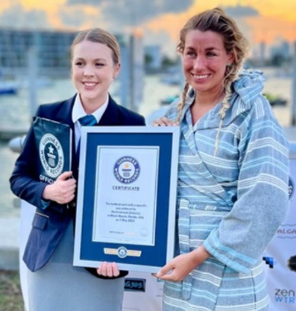
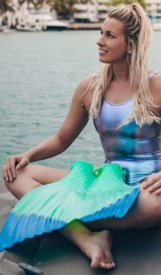
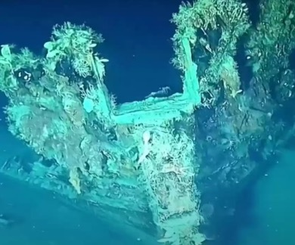
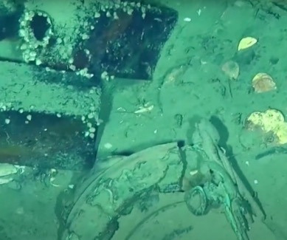
20 – 26 June
YOUR WEEKLY NEWSPAPER
Shipwreck treasures
P
ictures of a shipwreck, containing lots of lost treasure, have recently been shared by Colombia’s army. The video shows the legendary San Jose galleon shipwreck, the Spanish flagship sunk by the British Royal Navy in 1708. It had been hidden underwater for hundreds of years, until its discovery in 2015, and is believed to have been carrying riches that would be worth billions of pounds today! The Colombian army are keeping the exact location of the treasure a secret, but the video shows an enormous bounty aboard the vessel including, gold and silver coins, emeralds, ancient cannons, intact Chinese porcelain, pottery, and gold ingots! The Colombian army used a remotely operated submersible vehicle that dived to a depth of almost a kilometre. They also found two other shipwrecks, one of a colonial galleon and another of a schooner, which is thought to date back to Colombia's war for independence from Spain in 1819.
Pictured: Merle Liivand receiving her Guiness World Record certificate, and with her monofin.
Source: Guinness World Records @GWR Twitter page.
Farthest swim with a monofin
M
erle Liivand has broken her own Guinness World Record by swimming 26.22 miles (42.2km) in the ocean whilst wearing a monofin. The Estonian swimmer and conservationist, known as the ‘eco mermaid’, spent 11 hours and 54 minutes swimming off the coast of Miami Beach, Florida. She completed the record-breaking attempt on World Oceans Day, as she wants to highlight the problem of plastic pollution in our oceans and
help create cleaner waters across the globe. “I was born with auto-immune health problems, and I started swimming because my lungs collapsed,” Liivand told Guinness World Records. “Today, my intention is to fight for Mother Earth's lungs.” Although she was stung by a jellyfish during the swimming challenge, she also had positive interactions with some dolphins and a mother manatee with a baby.
Pictured: The shipwreck and treasure shared by the Colombian army.
Source: Colombian National Navy.
Share your thoughts and read the opinions of others
www.picture-news.co.uk/discuss
© Picture News 2022
Notes:
A

Slide 16
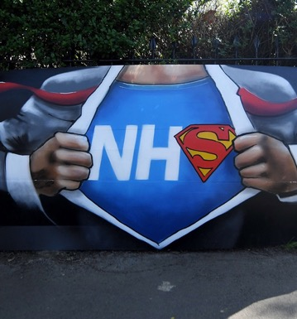
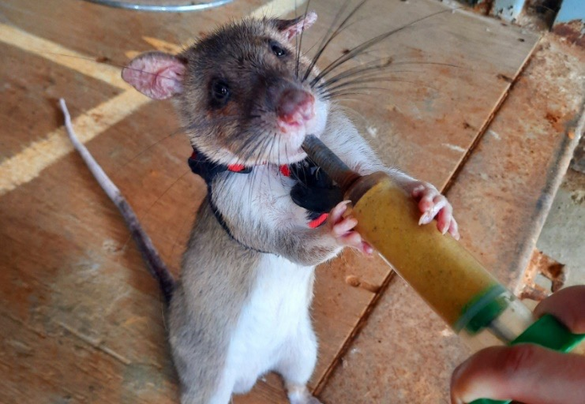
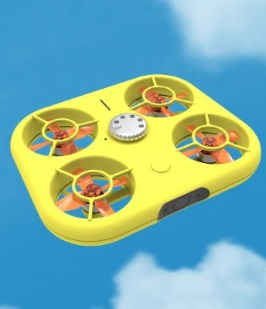
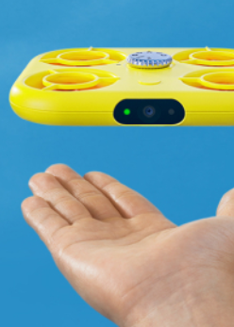
Search and rescue ’Hero Rats’
Last week’s topic:
Dr Donna Kean has been working on training African giant pouched rats to go into earthquake debris wearing tiny specialist backpacks containing microphones, video equipment and location trackers, so rescue teams can talk to survivors. The research scientist from Scotland, who is working with APOPO HeroRATs project, tweeted, “I train these clever creatures to save victims trapped in collapsed buildings after earthquakes. We kit them out with a rat backpack, and train them to trigger a switch when they find a
victim and come back for a tasty treat.” The rats have a great sense of smell, can move through small spaces and can be trained very quickly – it only took two weeks to train the seven rats! When they locate a person, they pull a rubber ball on their backpack, which provides a signal to rescuers. The smart rat then returns to its trainer to be fed a reward of powdered rat pellets mixed with avocado and banana through a syringe, as pictured.
Can anyone be a hero?
I think we all could be, but we aren't as not everyone chooses to do the right thing.
Lainey
No. Some people just want to help and not be the centre of attention like a hero often is.
Alec
You can be a hero but not those who fly. You can be a doctor and save lives, be a scientist and discover ways to heal mankind, you can be an astronaut and see new planets ahead for humans and finally, you can be a parent going in the day working hard to bring food on the table.
Atnasya – age 10
Let us know what you think about this week’s news?
www.picture-news.co.uk/discuss
Picture News Ltd,
Colber Lane,
Bishop Thornton,
Harrogate,
North Yorkshire, HG3 3JR
help@picture-news.co.uk
Pictured: A rat fitted with a backpack undergoing search and rescue training.
Source: Dr Donna Kean’s Twitter page
@HelpPicture
Share your thoughts and read the opinions of others
www.picture-news.co.uk/discuss
© Picture News 2022

Slide 17
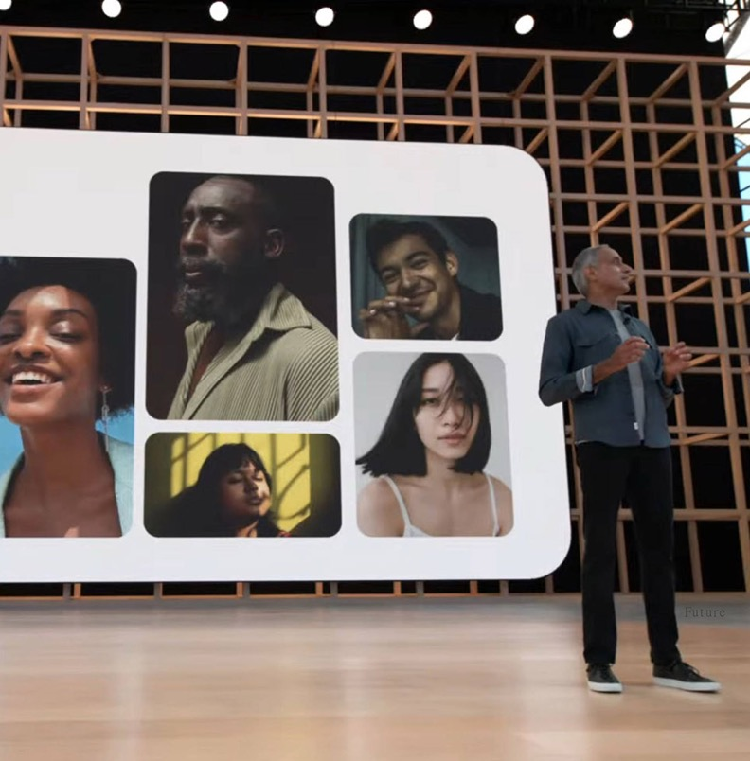
In the news this week
20 – 26 June
The technology company, Google, has recently announced changes to its search engine, including the introduction of the ‘Monk Skin Tone Scale’ to help make search results more inclusive by showing a wider range of skin tones. Professor Dr Ellis Monk (creator of the Monk Skin Tone Scale) and Google aim to tackle the unfair balance of skin tones people see when searching online.
Things to talk about at home ...
Can you think of a time when you didn’t feel you were treated fairly or were fairly represented?
Can you think of an example of how to make others around you feel they have been treated fairly?
Do you think that seeing a wider range of people and skin tones when searching the internet will have a positive impact?
How can we make sure that everyone is included?
Please note any interesting thoughts or comments
Share your thoughts and read the opinions of others
www.picture-news.co.uk/discuss
© Picture News 2022

